Slide 1

CS 784: Advanced Topics in Data Management This semester’s focus: Data Science
AnHai Doan
Notes:
Let me start this talk by telling you how I got to social media. For that, I need to go back to the year 2001.

Slide 2
What We Will Discuss
Logistic
course enrollment
no class this Friday
What is data science?
Motivation, the rise of data science
What CS at UW-Madison is doing about it
What will be covered in this class, goals of the class
Course syllabus
Next step

Slide 3
Data Science
No one really knows what it is
There is a popular joke about this
A very common definition
data science focuses on extracting (actionable) insights/knowledge from data
This does not really capture all DS activities “in the wild”

Slide 4
Data Science
Tasks
extract insights from data = performing analysis
build data-driven artifacts: knowledge bases, rec systems, …
design data-driven experiments to answer a question
Need to know
database management (RDBMSs), machine learning, AI, data mining
managing different kinds of data (relational, text, Web, graph, time series, etc)
statistics
optimization, linear algebra
visualization
big data systems
distributed/parallel systems, networking
security/privacy
Skills
Python/R data science eco systems
Big data systems: Hadoop, Spark, NoSQL
SQL

Slide 5
How is DS Different From …
RDBMSs
data mining
statistics
Big Data

Slide 6
Motivation / The Rise of Data Science
RDBMSs
transactional data management, belong to the CIO
Web => Google, other Web companies
Three trends
much easier to generate and capture data
much easier to process data (eg on the cloud)
many more people become involved
Lead to Big Data
change in perception: data is now at the heart of enterprises
lot of data, how to process it? => big data systems
how to store/query it? => NoSQL databases
how to get value out of it? => data analytics, data science

Slide 7
Examples
Johnson Control
WalmartLabs
product catalog
product matching
Non-profit organizations’ database
My house
My car
GE and the Internet of Things
Google Knowledge Graph
AB testing
Everything is increasingly data driven

Slide 8
What CS @ UW-Madison Is Doing About This?
Data science is very hot today (sexiest job of the century, etc.)
pays very well out there, many bootcamps
What we think
we have seen fads come and gone
is this a fad? it’s likely that it will stay
the fundamental fact is that everything is increasingly data driven (electricity, digital, online)
so a lot of people and skills are needed to process data
so even if the name data science disappears, the fundamental problem will remain
Our current plan
design a sequence of DS courses for grad students: 784, 838, …
design a sequence of DS courses for ugrads (eventually opening up to the entire UW)
design DS plans for the db group, CS dept, and UW-Madison
many universities are doing the same thing
your ideas? What do you want to see?

Slide 9
Coverage and Goals of this Class
Tasks
extract insights from data = performing analysis
build data-driven artifacts: knowledge bases, rec systems, …
design data-driven experiments to answer a question
Need to know
database management (RDBMSs), machine learning, AI, data mining
managing different kinds of data (relational, text, Web, graph, time series, etc)
statistics
optimization, linear algebra
visualization
big data systems
distributed/parallel systems, networking
security/privacy
Skills
Python/R data science eco systems
Big data systems: Hadoop, Spark, NoSQL
SQL

Slide 10
Coverage and Goals of this Class
Tasks
extract insights from data = performing analysis
main focus of this class
let’s illustrate this using an example

Slide 11
Example
Company has multiple departments
Depts interact with customers
Boss wants to know
how are customer complaints distributed across depts?
are there any interesting patterns regarding customer complaints?
can we predict anything regarding customer complaints and can we take any action?
You the data scientist start by collecting data
Emps(eid, name, phone, address, did)
Depts(did, name)
Complaints(cid, cname, ename, phone, dname, date, desc)
Services(sid, date, desc)
Subsequent steps
data extraction
data understanding, cleaning, transformation
data integration
(most likely) data understanding, cleaning, transformation again
data analysis

Slide 12
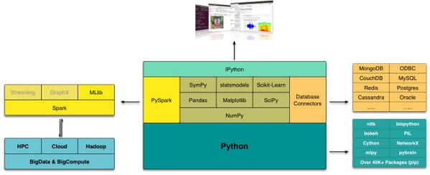
Example
You will most likely do two stages
development
production
Using a data analysis stack and a big data stack

Slide 13
Course Syllabus
Big picture
RDBMS, machine learning, crowdsourcing, big data systems
Extracting insights from data
Data acquisition, data lake
The development stage
Data extraction: from HTML pages, from text
Data understanding, cleaning, transforming
Data integration: matching schemas, matching entities
Data exploration/analysis
The production stage
Building artifacts
Designing data-intensive experiments to answer questions
Misc
managing different kinds of data: text, Web, social media

Slide 14
Misc Issues
Reading and lecture notes
Project

